Slide 1
Python – Object Oriented

Slide 2

30 Days Data Scinece & Analytics Master Class
Day1 : Python for Data Science
Time: 6.00 PM IST
Free Registration

Slide 3
30 Days Data Scinece & Analytics Master Class
Handbook

Slide 4

What is Master Class ?
👍 This is the 30 Days Industrial Learning Activity.
👍 Its Online YouTube Live Class
👍 If you Invest 45 minutes daily, U will become Master in Data Science
👍 You will get FREE E-Certificate
Webinar Participation Certificate
“Learning is the beginning of wealth.
Searching & Learning is where the miracle process all begins.” …………….Jim Rohn

Slide 5
Pantech?
Educational Equipment Manufacturer
IoT, AI, Robotics,Autonomous Robot
Microprocessor/Microcontroller
DSP,VLSI, Embedded System
Power Electronics & Drives, Fuel Cell Trainer Kit
Renewable Energy Lab, Electric Vehicle Lab
Technical Training
DIY Project

Slide 6
Our Vision
Help 10 Million Students to Learn the Technology in Easy Way

Slide 7

Associate Partner for this Master Class
https://apssdc.in/home/

Slide 8
NANDHINI.S
Exp: 5 Yrs
Expert in
Python Developer on Machine Learning
Deep learning with computer vision
Matlab – Image Processing
Autonomous Car design using ROS with LIDAR
Language – Python , Java , HTML ,CSS.
Tools – ANACONDA NAVIGATOR, JUPYTER NOTEBOOK,
GOOGLE COLAB.
Graduation : BE – ECE | 2011

Slide 9
What U will Learn from 30 Days Data Science & Analytics Master Class

Slide 10
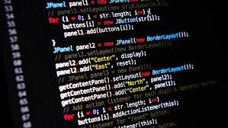
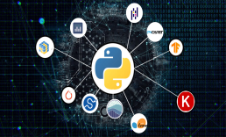



Data Science & Analytics Learning Plan
01
02
03
04
05
Library
Python
Analytics
Tools
Industry Project
Introduction To Python and Python Data Structures
Pandas
Numpy
MatplotLib
Cborn, SKLearn Lib
Collab
Distribution
Visualization
Aggregation
Statistics
PowerBi
Tableo
Project Building,
DSA Jobs

Slide 11
Day wise Learning Plan
Day -1 : Python for Data Science (5 Solved end-to-end Data Science Projects in Python)
Day -2: Advanced Python Programming
Day -3: Pandas Library – Introduction
Day -4: Pandas Library – Data Structures
Day -5: Numpy library – Array Operations | Mathematical Functions
Day -6: Numpy – Sort, Search and Counting Functions
Day -7: Matplotlib , Histogram Using Matplotlib | I/O With Numpy
Day -8: Matplotlib Library – Introduction , Pyplot API | Types Of Plots
Day -9: Seaborn Library
Day -10: SKLearn Library
Day -11: Google Colab Notebook
Day -12: Python – Date and Time, Data Wrangling
Day -13: Python – Data Aggregation
Day -14: Python – Word Tokenization , Stemming and Lammetization
Day -15: Python – Data Visualization

Slide 12
Day wise Learning Plan
Day -16: Python – Statistical Analysis
Day -17: Python – Types Of Distribution
Day -18: Python – Correlation ,Chi-Square Test , Linear Regression
Day -19: Tableau – Introduction and Tools
Day -20: Tableau – Data Sources , Worksheets
Day -21: Spatial Data Science For Covid-19 Disease Prediction
Day -22: Power-BI – Introduction, Installation Steps and Architecture
Day -23: Power-BI – Data Modelling , Visualization Options | Excel Integration
Day -24: Parkinson’s Disease Prediction – XG Boost Classifier
Day -25: House Price Prediction using Random Forest Regression
Day -26: Customer Segmentation Using ML – K-Means Clustering
Day -27: Home Loan Prediction using Decision Tree Classifier
Day -28: Spam Classification using NLP
Day -29: Hand Written Digit Recognition Using CNN
Day -30: Churn Prediction using Deep Learning

Slide 13
List of Projects for Demo in YouTube Live
Spatial Data Science For Covid-19 Disease Prediction
Parkinson’s Disease Prediction-XGBoost Classifier
House Price Prediction-Random Forest Regression
Customer Segmentation Using ML-K-Means Clustering
Home Loan Prediction-Decision Tree Classifier
Spam Classification-NLP
Hand Written Digit Recognition Using Python-CNN
Churn Prediction-Deep Learning
Crop Yield Prediction
Ground water level prediction
All Projects in Jupyter Notebook

Slide 14
What you will get from this Free 30 Days Master Class?
You can attend YouTube Live Class
Free E-Certificate ( WEBINAR PARTICIPATION CERTIFICATE)

Slide 15
How to mark your Attendance in YouTube Live Class?
Ans : During the Live Class, organizer will post Google Form link in Live Chat. The Participants should submit the from on daily basis. Minimum 25 Days Attendance is Required to get Free Master Class Participation Certificate.
Note : The Link will be available during the Live. From the LIVE Class date, the live video will get removed from the YouTube in 3 days.

Slide 16
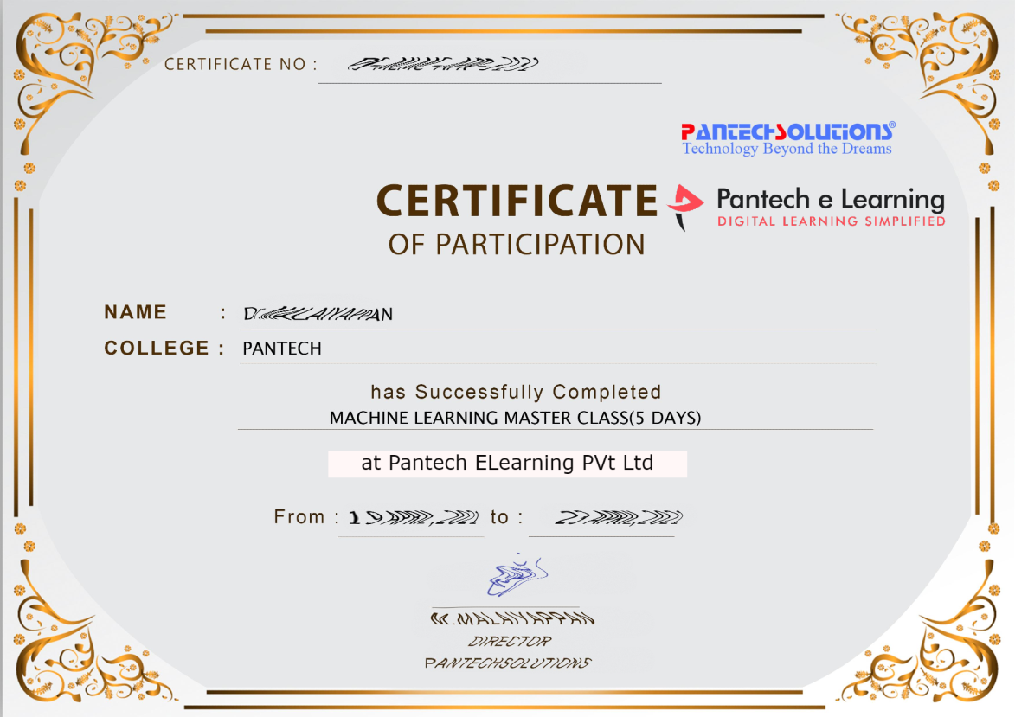

Sample Webinar Participation Certificate?

Slide 17
https://www.pantechelearning.com/data-science-master-class/
On Demand
You can get chance to apply 1 Month Internship on Data Science & Analytics Master Class

Slide 18
What is Internship????
Learn
Practice
Verify
Get Certified
Grow

Slide 19
Free Master Class DSA | 1 Month Internship on DSA
Master Class Participation Certificate | Internship Completion Certificate
Minimum 25 Class should attend YouTube Live | Recorded Class Link will be provided. – LMS Portal Access
YouTube Live Mandatory | Your Choice. You can attend Live or else You can watch Recorded Class in LMS Portal
All Projects Demo class in YouTube Live | Step by Step Video Explanation Content in LMS Portal
Access : 3 Days | VIP WhatsApp Group Support
 | You Can Download All PPTs
 | 4 Nos of Hackathon Class in Zoom Live. The Recording also will be provided
 | You Can Download All Project Files
 | Mentor will guide you to finish 10 Projects
 | Access : 60 Days

Slide 20
Pantech will make you to Create 10 Projects in Data Science & Analytics in 30 Days
Objective of this 30 Days Master Class

Slide 21
1 Month Internship in Data Science
INTERNSHIP E-Certificate(30Days Internship on Data Science Engineering)
Highly organized Video content
Download All Files
Download PPTs
Assignments
Flexible Time.
Access Period: 60Days from the date of payment

Slide 22
What You Will Get???
Complete Project Files
30 Days Learning Activity
Data Science Core Concepts
10 + Projects
Project PPT
Spatial Data Science For Covid-19 Disease Prediction
Parkinson’s Disease Prediction-XGBoost Classifier
House Price Prediction-Random Forest Regression
Customer Segmentation Using ML-K-Means Clustering
Home Loan Prediction-Decision Tree Classifier
Spam Classification-NLP
Hand Written Digit Recognition Using Python-CNN
Churn Prediction-Deep Learning
Crop Yield Prediction
Ground water level prediction
Video Class Access for 2 Months
Get chance to Enroll 1-Month Internship on demand

Slide 23

How to join in 1 month Internship
https://www.pantechelearning.com/data-science-master-class/
Click Here
Coupon Code: WELCOMEDSE

Slide 24
Creating Classes
The class statement creates a new class definition.
The name of the class immediately follows the keyword class followed by a colon:
Syntax:
class ClassName:
'Optional class documentation string'
class_suite

Slide 25
Creating Classes
The class has a documentation string , which can be accessed via ClassName.__doc__.
The class_suite contains all the component statements defining class members , data attributes and functions.

Slide 26
Creating Classes - Example
class Employee:
'Common base class for all employees'
empCount = 0
def __init__(self, name, salary):
self.name = name
self.salary = salary
Employee.empCount += 1
def displayCount(self):
print "Total Employee %d" % Employee.empCount
def displayEmployee(self):
print "Name : ", self.name, ", Salary: ", self.salary

Slide 27
Creating Classes
The variable empCount is a class variable whose value is shared among all the instances of the class.
The first method __init__() is a special method , which is called class constructor or initialization method that python calls when you create a new instance of a class.
You declare other class methods like normal functions with the exception that each the first argument to each method is self.

Slide 28
Creating Instance Objects
To create instances of the class , we call the class using the class name and pass in whatever arguments in its __init__ method accepts.
"This would create first object of Employee class"
emp1 = Employee("Zara", 2000)
"This would create second object of Employee class"
emp2 = Employee("Manni", 5000)

Slide 29
Accessing Attributes
We can access the object’s attribute using the dot operator with object.
Class variable could be accessed using the class name.
emp1.displayEmployee()
emp2.displayEmployee()
print "Total Employee %d" % Employee.empCount

Slide 30
Example:
#!/usr/bin/python
class Employee:
'Common base class for all employees'
empCount = 0
def __init__(self, name, salary):
self.name = name
self.salary = salary
Employee.empCount += 1
def displayCount(self):
print "Total Employee %d" % Employee.empCount

Slide 31
Example
def displayEmployee(self):
print "Name : ", self.name, ", Salary: ", self.salary
"This would create first object of Employee class"
emp1 = Employee("Zara", 2000)
"This would create second object of Employee class"
emp2 = Employee("Manni", 5000)
emp1.displayEmployee()
emp2.displayEmployee()
print "Total Employee %d" % Employee.empCount

Slide 32
Output
Name : Zara ,Salary: 2000
Name : Manni ,Salary: 5000
Total Employee 2

Slide 33
Accessing Attributes
We can add , remove or modify attributes of classes and objects at any time.
emp1.age = 7 # Add an 'age' attribute.
emp1.age = 8 # Modify 'age' attribute.
del emp1.age # Delete 'age' attribute.

Slide 34
Accessing Attributes
Instead of using normal statements to access attributes , we can use the following functions:
The getattr(obj, name[, default]) − to access the attribute of object.
The hasattr(obj,name) − to check if an attribute exists or not.
The setattr(obj,name,value) − to set an attribute. If attribute does not exist, then it would be created.
The delattr(obj, name) − to delete an attribute.

Slide 35
Accessing Attributes
hasattr(emp1, 'age') # Returns true if 'age' attribute exists
getattr(emp1, 'age') # Returns value of 'age' attribute
setattr(emp1, 'age', 8) # Set attribute 'age' at 8
delattr(empl, 'age') # Delete attribute 'age'

Slide 36
Built-In Class Attributes
Every python class keeps following built-in attributes and they can be accessed using dot operator.
__dict__ − Dictionary containing the class's namespace.
__doc__ − Class documentation string or none, if undefined.
__name__ − Class name.
__module__ − Module name in which the class is defined. This attribute is "__main__" in interactive mode.
__bases__ − A possibly empty tuple containing the base classes, in the order of their occurrence in the base class list.

Slide 37
Built-In Class Attributes - Example
#!/usr/bin/python
class Employee:
'Common base class for all employees'
empCount = 0
def __init__(self, name, salary):
self.name = name
self.salary = salary
Employee.empCount += 1
def displayCount(self):
print "Total Employee %d" % Employee.empCount

Slide 38
Built-In Class Attributes - Example
def displayEmployee(self):
print "Name : ", self.name, ", Salary: ", self.salary
print "Employee.__doc__:", Employee.__doc__
print "Employee.__name__:", Employee.__name__
print "Employee.__module__:", Employee.__module__
print "Employee.__bases__:", Employee.__bases__
print "Employee.__dict__:", Employee.__dict__

Slide 39
Output
Employee.__doc__: Common base class for all employees Employee.__name__: Employee
Employee.__module__: __main__
Employee.__bases__: ()
Employee.__dict__: {'__module__': '__main__', 'displayCount': <function displayCount at 0xb7c84994>, 'empCount': 2, 'displayEmployee': <function displayEmployee at 0xb7c8441c>, '__doc__': 'Common base class for all employees', '__init__': <function __init__ at 0xb7c846bc>}

Slide 40
Destroying Objects
Python deletes unneeded objects automatically to free the empty space.
The process by which Python periodically reclaims block of memory that are no longer in use is termed Garbage Collection.
a = 40 # Create object <40>
b = a # Increase ref. count of <40>
c = [b] # Increase ref. count of <40>
del a # Decrease ref. count of <40>
b = 100 # Decrease ref. count of <40>
c[0] = -1 # Decrease ref. count of <40>

Slide 41
Destroying Objects - Example
This __del__() destructor prints the class name of an instance that is about to be destroyed.
#!/usr/bin/python
class Point:
def __init__( self, x=0, y=0):
self.x = x
self.y = y
def __del__(self):
class_name = self.__class__.__name__
print class_name, "destroyed"

Slide 42
Destroying Objects - Example
pt1 = Point()
pt2 = pt1
pt3 = pt1
print id(pt1), id(pt2), id(pt3) # prints the ids of the obejcts
del pt1
del pt2
del pt3

Slide 43
Class Inheritance
We can create a class by deriving it from the preexisting class by listing the parent class in the parentheses after the new class name.
The child class inherits the attributes of the parent class , and we can use those attributes as if they were defined in the child class.
Syntax:
class SubClassName (ParentClass1[, ParentClass2, ...]):
'Optional class documentation string'
class_suite

Slide 44
Example
#!/usr/bin/python
class Parent: # define parent class
parentAttr = 100
def __init__(self):
print "Calling parent constructor"
def parentMethod(self):
print 'Calling parent method'

Slide 45
Example
def setAttr(self, attr):
Parent.parentAttr = attr
def getAttr(self):
print "Parent attribute :", Parent.parentAttr

Slide 46
Example
class Child(Parent): # define child class
def __init__(self):
print "Calling child constructor"
def childMethod(self):
print 'Calling child method'
c = Child() # instance of child
c.childMethod() # child calls its method
c.setAttr(200) # again call parent's method
c.getAttr() # again call parent's method

Slide 47
Output:
Calling child constructor
Calling child method
Calling parent method
Parent attribute : 200

Slide 48
Multiple Inheritance
We can derive a class from multiple parent classes:
class A: # define your class A
.....
class B: # define your class B
.....
class C(A, B): # subclass of A and B
.....

Slide 49
Multiple Inheritance
You can use issubclass() or isinstance() functions to check a relationships of two classes and instances.
The issubclass(sub, sup) boolean function returns true if the given subclass sub is indeed a subclass of the superclass sup.
The isinstance(obj, Class) boolean function returns true if obj is an instance of class Class or is an instance of a subclass of Class

Slide 50
Overriding Methods
We can always override parent class methods.
One reason for overriding parent's methods is because you may want special or different functionality in your subclass.

Slide 51
Overriding Methods - Example
#!/usr/bin/python
class Parent: # define parent class
def myMethod(self):
print 'Calling parent method'
class Child(Parent): # define child class
def myMethod(self):
print 'Calling child method'
c = Child() # instance of child
c.myMethod() # child calls overridden method

Slide 52
Output
Calling child method

Slide 53
Overloading Operators
Suppose you have created a Vector class to represent two-dimensional vectors, what happens when you use the plus operator to add them? Most likely Python will yell at you.
You could, however, define the __add__ method in your class to perform vector addition and then the plus operator would behave as per expectation −

Slide 54
Example
#!/usr/bin/python
class Vector:
def __init__(self, a, b):
self.a = a
self.b = b
def __str__(self):
return 'Vector (%d, %d)' % (self.a, self.b)

Slide 55
Example
def __add__(self,other):
return Vector(self.a + other.a, self.b + other.b)
v1 = Vector(2,10)
v2 = Vector(5,-2)
print v1 + v2

Slide 56
Output
Vector(7,8)

Slide 57
Data Hiding
An object's attributes may or may not be visible outside the class definition.
You need to name attributes with a double underscore prefix, and those attributes then are not be directly visible to outsiders.

Slide 58
Data Hiding
#!/usr/bin/python
class JustCounter:
__secretCount = 0
def count(self):
self.__secretCount += 1
print self.__secretCount
counter = JustCounter()
counter.count()
counter.count()
print counter.__secretCount

Slide 59
Output
Python protects those members by internally changing the name to include the class name.
You can access such attributes as object._className__attrName. If you would replace your last line as following, then it works for you −

Slide 60
Data Hiding
.........................
print counter._JustCounter__secretCount.
Output:
1
2
2

